Slide 1
Anaerobic ENERGY

Slide 2
Introduction

Slide 3
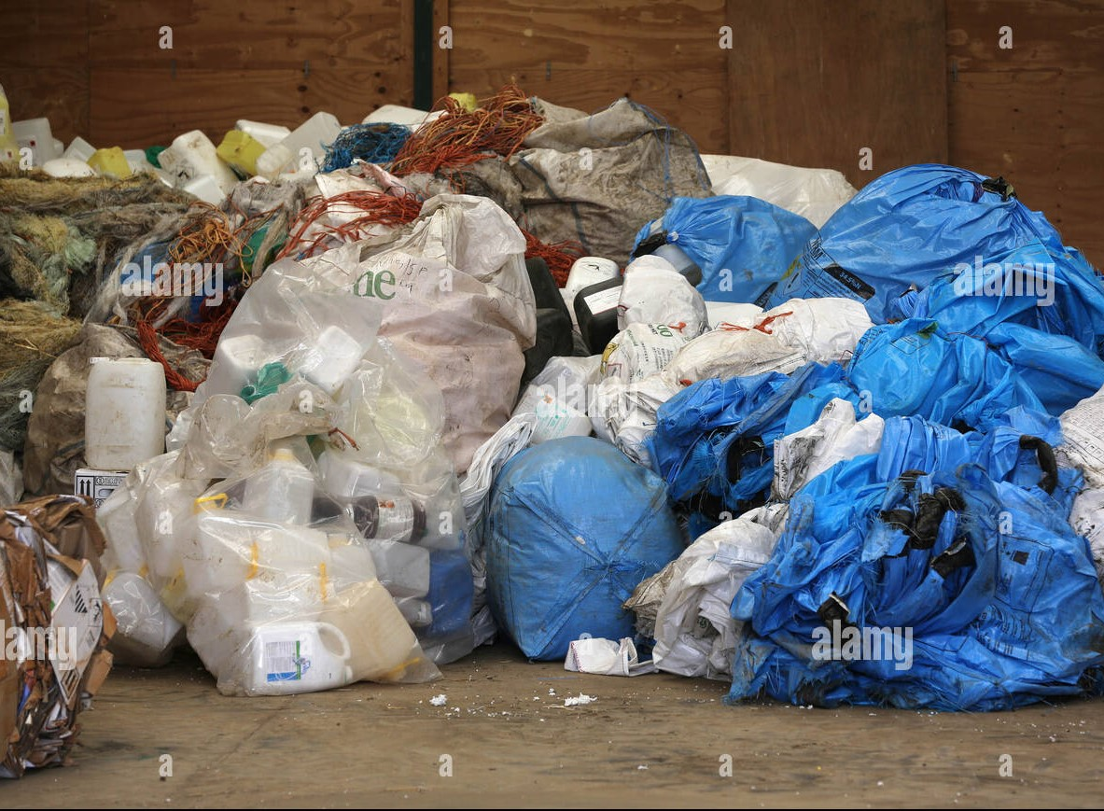
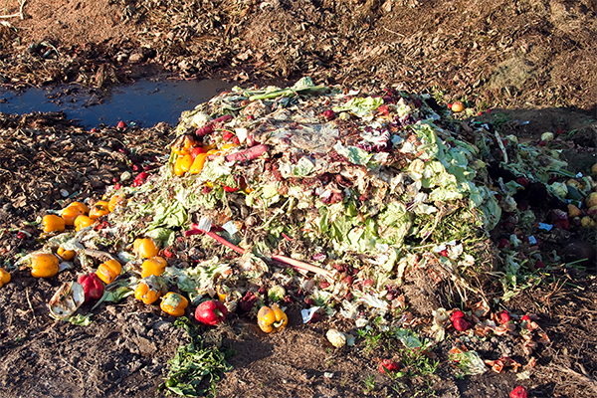
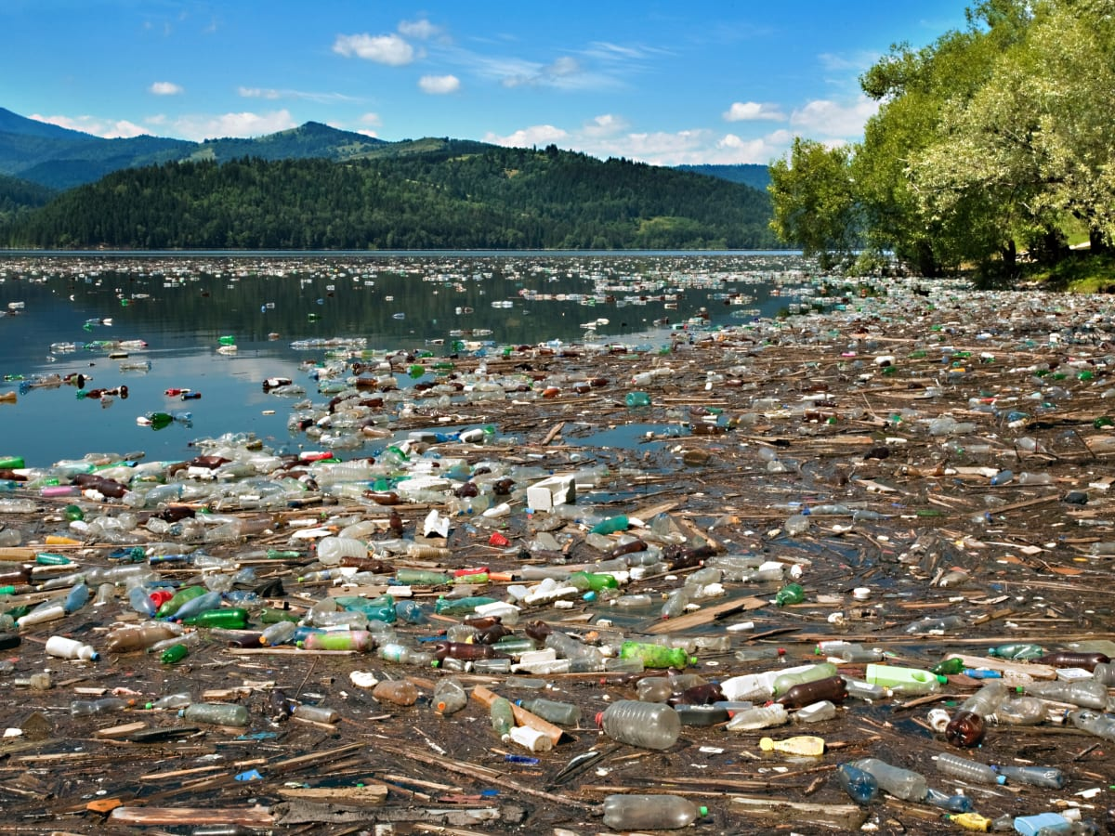
The world suffers from cancerous challenges especially the five connected challenges of Recycling, pollution, health problems, agricultural wastes, and energy loss. Recycling is the process of converting waste materials into reusable objects to prevent waste of potentially useful materials, and reduce the consumption of fresh raw materials, energy usage, and water pollution. Water pollution is the presence of harmful materials in water, such as sewage, dissolved metal, waste from farms, factories, and crude oil spilled from oil tankers. According to the United Nations, 783 million people do not have access to clean water and around 2.5 billion do not have access to adequate sanitation. The most common contaminants are bacteria and mercury. The bacteria and mercury will cause many health problems. Agriculture is very important in our daily life because it’s the main source of food but the plant as potato used high amounts of water that cause many water problems (water loss) and energy loss. So, we have found that energy is very important so we have chosen our idea to use water in potatoes mixed with bacteria to give us methane gas and as we know that methane is very harmful so we change it to hydrogen.

Slide 4
Analysis and Discussion

Slide 5
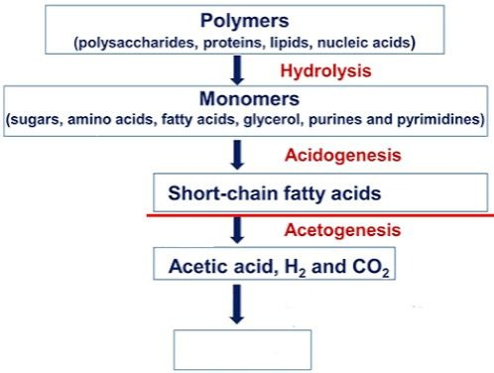
The essence of the idea:
The idea of our project is to get a source of energy from the digestion of any organic compound with anaerobic bacteria in a process called (Anaerobic Digestion).
The digestion process begins with bacterial hydrolysis. It involves the conservation of polymeric organic material (lipids, proteins) to monomers (sugars, fatty acids, and amino acids) by using some enzymes. The second process is acidogenesis which converts monomers to short-chain fatty acids. The next process is acetogenesis which converts short chains to acidic acid, hydrogen, and Co2.(Shown in fig.1)
$6{CO}_{2 fig.1 }$

Slide 6
Components of the project:
The organic compound could be that water that came from farming the potatoes with some molas that could be a by-product from sugar cane factories .This water must be at a specific temperature and the PH of the water must be between 6.8 to 7.2.
Products of the project:
After the bacteria digest the COD which is Chemical Oxygen Demand in the water it emits biogas that contains from 75% to 85% methane gas and 15% to 25% carbon dioxide and part of the water that used become good to use in agriculture.
Calculations and laws:
The percentage of the polluted water that used to the water that became good in agriculture is 3 : 0.5 . As we use 20 liters of polluted water, we gained 3.5 liters of good water in agriculture.
Every 12 hours, we put 10 liters of polluted water and the double of this amount for the bacteria. So, For every 10 liters of polluted water, we put 20 liters of anaerobic bacteria by the percentage of 1:2.

Slide 7
Calculations and laws:
Theoretical yield for methane production per day was calculated by formula $\frac{\text{5000}\text{∗}\text{80}\text{\%∗}\text{0}\text{.}\text{35}\text{∗}20}{24}$ * 75% = 874.5 ml per hour. Where 5000mg/l is the maximum amount of COD could be in the potato, 80% is COD performance, 20 is amount of water liters, 0.35 is biogas conversion factor to VASP reactor, 24 is number of hours in the day and 75% is the average amount of methane gas in bio gas. The actual yield for methane production per day was calculated by formula 700ml per hour. This mean that the amount of COD in the potatoes is 4000mg/l. The yield percentage =$\frac{\text{Actual} \text{yield}}{\text{Teoritical} \text{yield}}$ ∗ 𝟏𝟎𝟎% =$\frac{700}{874.5}$ × 𝟏𝟎𝟎% = 𝟖𝟎% . .where the amount of COD in potatoes from 3000 to 5000 mg/l.
Environment Protection:
As we know that methane gas and carbon dioxide gas have a bad effect on the environment so, after the process that happen in our solution, the biogas pass through a process called (Methane Steam Reformation). This process aims to make a reaction between methane gas and steam under a bid temperature. This will produce carbon monoxide and hydrogen gas with a formula : CH4 + H2O with Ni as a catalyst Co + 3H2

Slide 8
Environment Protection:
After that a water gas shift reaction which aims
Co + H2O Co2 + H2
By this hydrogen gas is obtained which is considered the cleanest source of energy and the carbon dioxide could be used by the manufacture of soft drinks or dry ice or could be absorbed with lime water.

Slide 9
Thank You

