Slide 1
Yuffi

Slide 2
Problems
Restaurants do not know their customers.
Ordering process in the restaurants lasts too long and is not Covid-19 friendly.

Slide 3
Solution
Virtual menus for restaurants, which would allow customers to order food using their phones by NFC tags.

Slide 4
User path
Customer sits down and touches the NFC tag with their phone
01
02
Virtual menu opens up in the customer’s phone browser
Customer views the dishes, orders them, and pays in just a few taps
03

Slide 5
Values for restaurants
Customer traffic analysis and their anonymous data.
Reduced costs for waiters’ salaries.
Real-time menu updates.
Visitors’ feedback.

Slide 6
Values for restaurant customers
Time is saved by speeding up the ordering process.
Personalized meal recommendations and discounts.
Ability for visitors to rate restaurants.
Reduced spread of the COVID-19 virus.

Slide 7
Market (in Lithuania)
4.000+
2.000+
Restaurants, bars, cafes & canteens
Pizza, burger & business lunch restaurants

Slide 8
Installation fee: 90-140 € (Based on the number of restaurant tables) | Basic plan | Advanced plan | Premium plan
Price | 299€/mth. | 499 €/mth. | 549€/mth.
Ordering process
Customers traffic analysis |  | Gender, age, time of the visit | Gender, age, time of the visit, eating habits
Food ordering analysis |  | Top 3 | All
Customer reviews & restaurant ratings

Slide 9
Competitors
 | NFC tags | Restaurants rating system | Personalized menus | Open network | Provides Information of restaurant visitors

Slide 10
Achievements
Won 2000€+ worth of prizes and investments
Created MVP
Got R-Keeper system’s API and documentation
Contacted with potential clients (Amber food, Delano networks)
Total of 35+ consultations with external partners (SEB, LiMA, Versli Lietuva, …)

Slide 11
Advertising - 2 campaigns
(Restaurants):
Direct communication
Social media (LinkedIn, etc.)
„Cold calling“ centers
(Restaurant customers):
Social media (location & interest based marketing)
Influencers
Information stands on tables
Internal ways of restaurant advertising

Slide 12
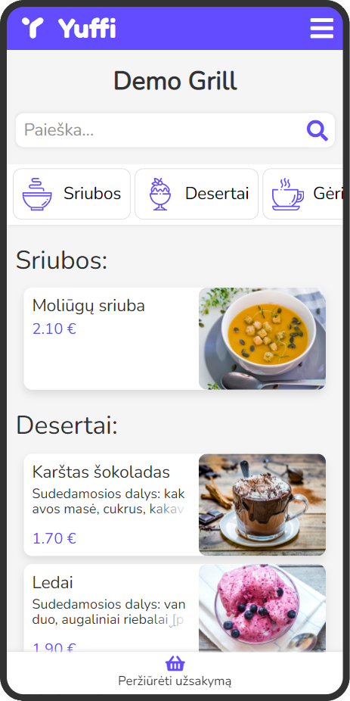
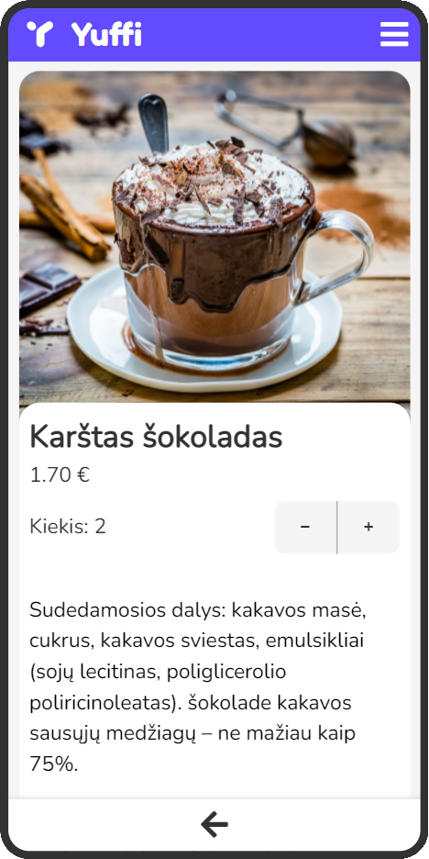
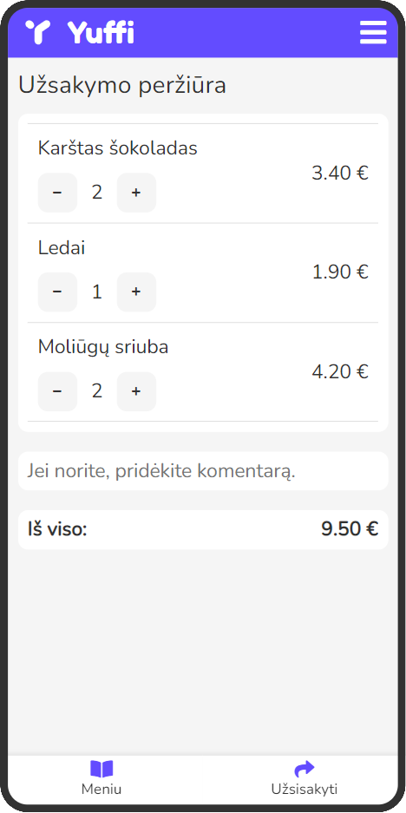

Slide 13
Future
New features:
Track order progress
Order food without being in a restaurant
Leave tips
Perspectives:
Patent the idea & trademark
Team expansion
Search for investments
Expansion into foreign markets

Slide 14
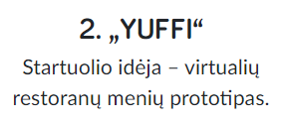
We have potential!

Slide 15
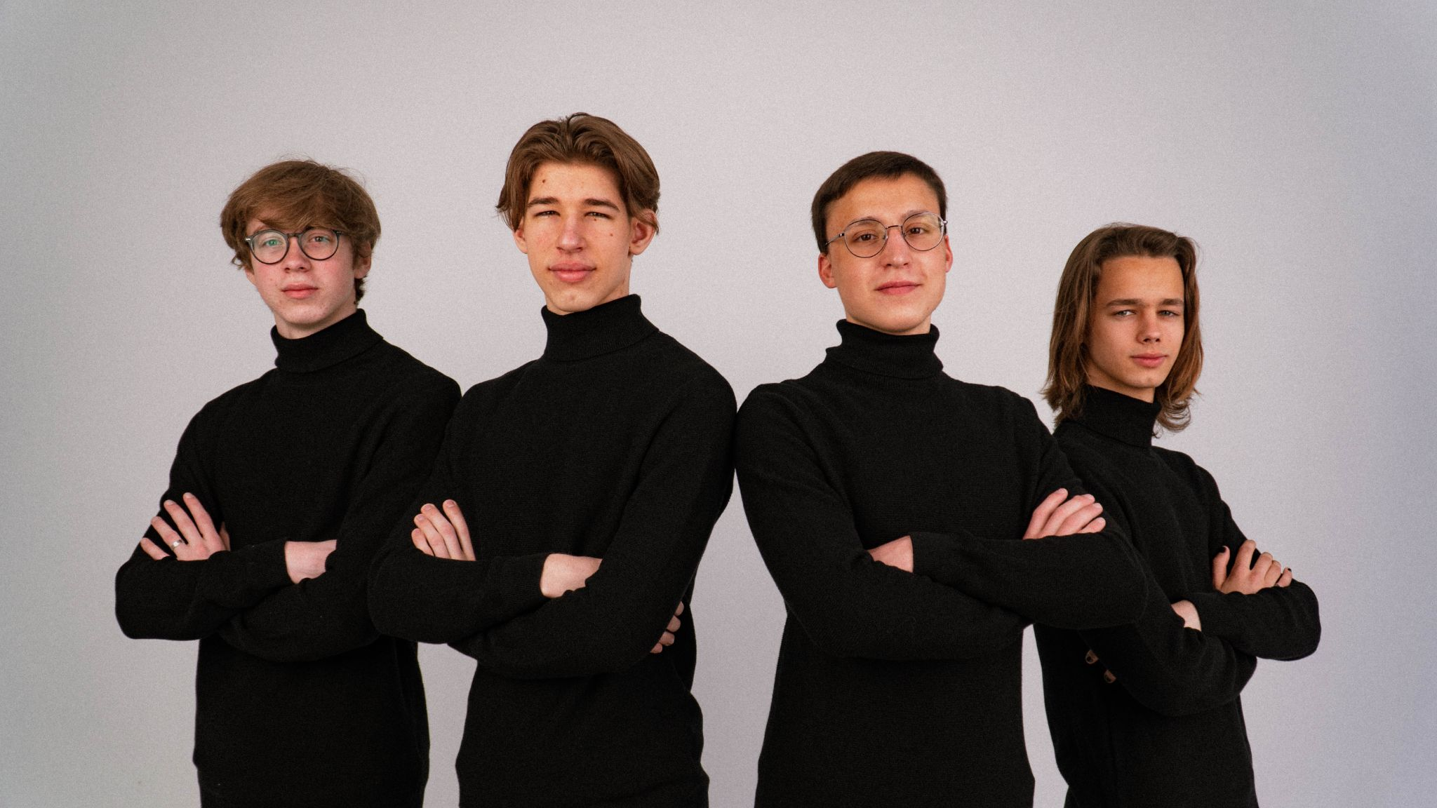
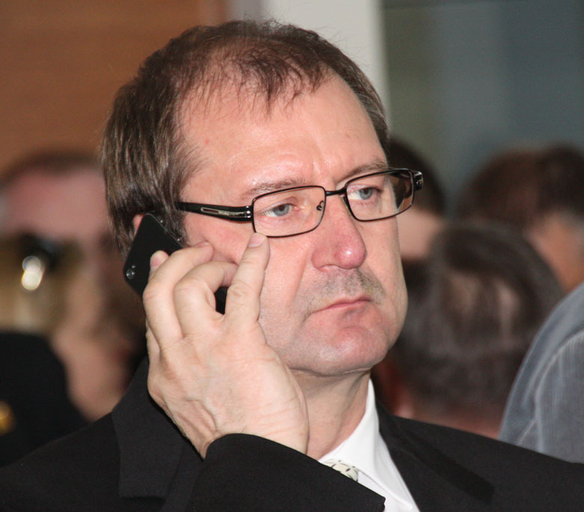
CEO
Benas Volkovas
Yuffi
CTO
Mykolas Aškelovičius
CSO
Vadim Čeremisinov
CMO
Ernestas Raudonis

Slide 16
Thanks!
Contact us: info@yuffi.lt
LinkedIn: linkedin.com/company/yuffi/
Website: yuffi.lt
Yuffi

